Slide 1
Developing the Conceptual Model
CE 547 – BRIGHAM YOUNG UNIVERSITY

Slide 2
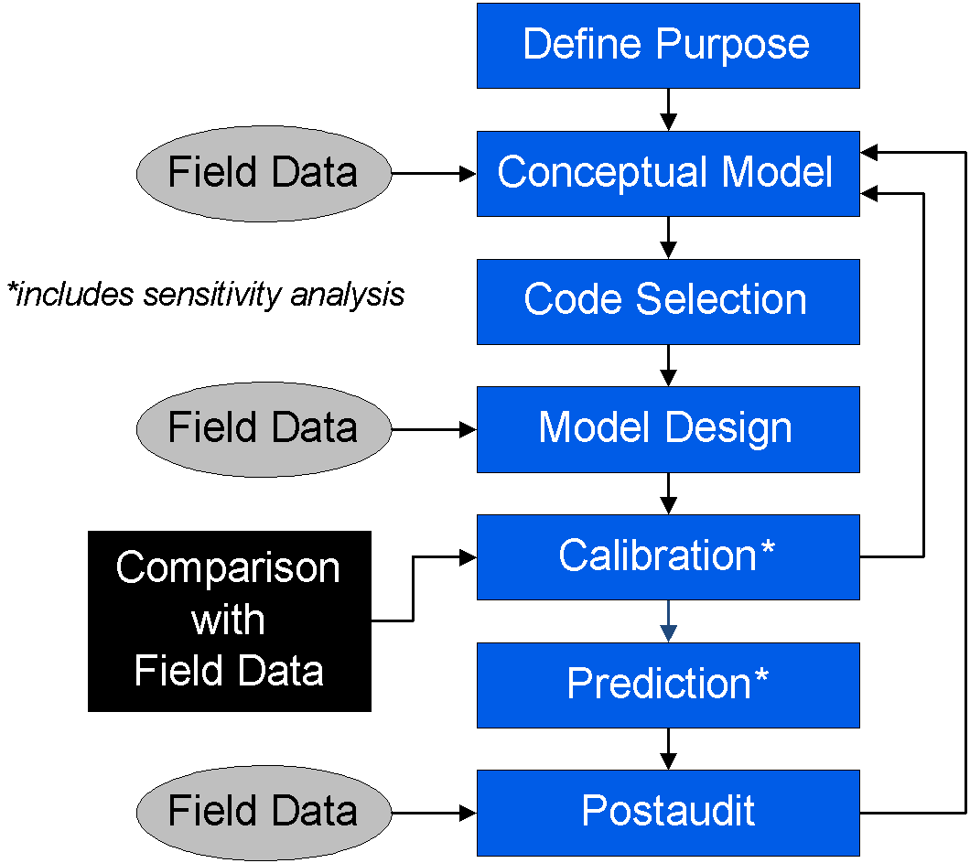
Definition
A simplified representation of a real aquifer system including the hydrogeologic units, boundaries, sources, and sinks

Slide 3
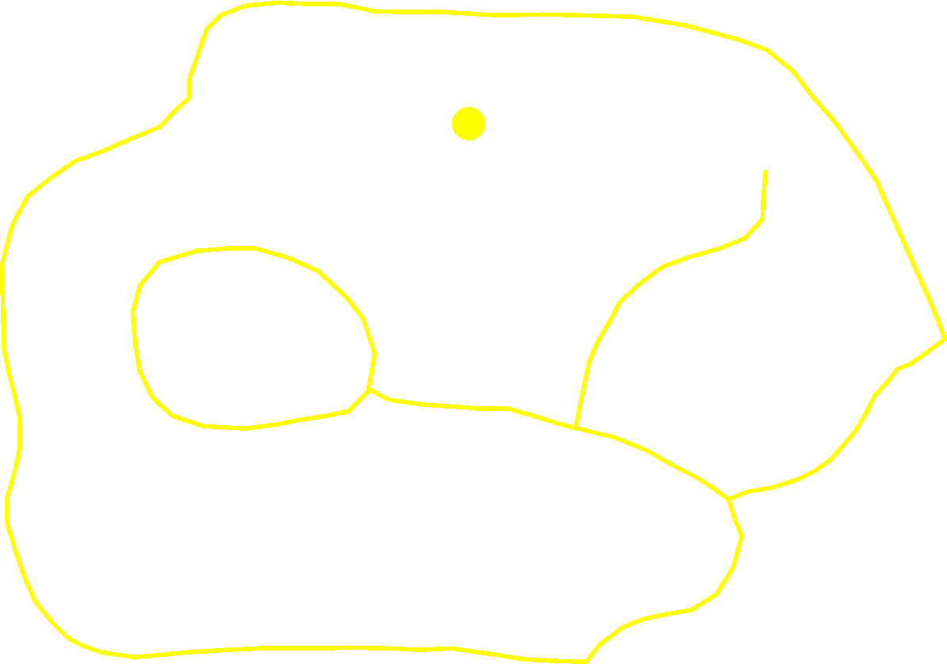
Conceptual Model

Slide 4
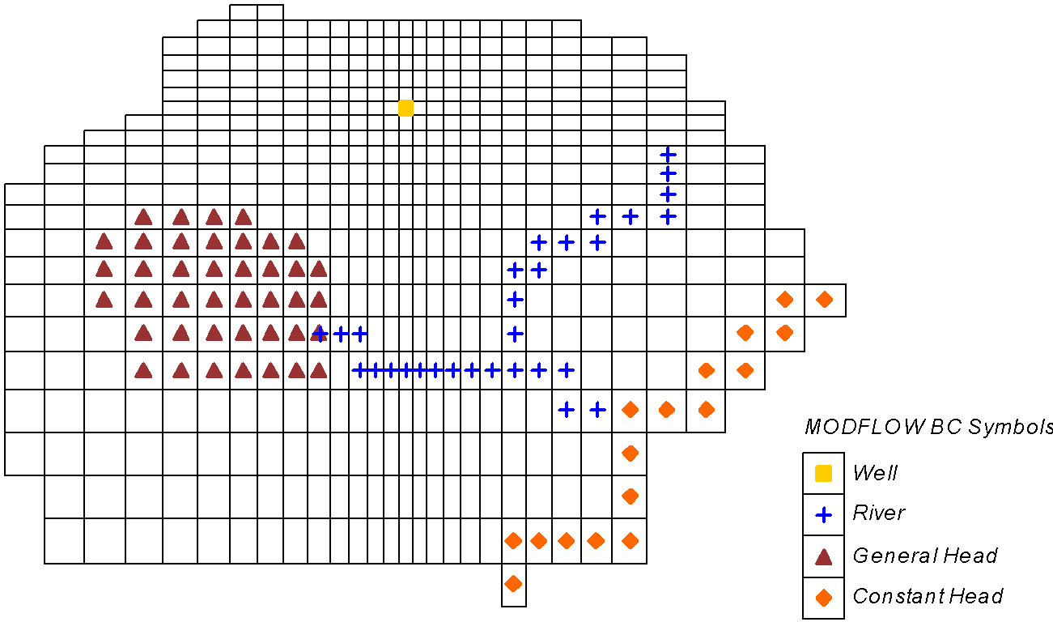
Grid-Based Numerical Model

Slide 5
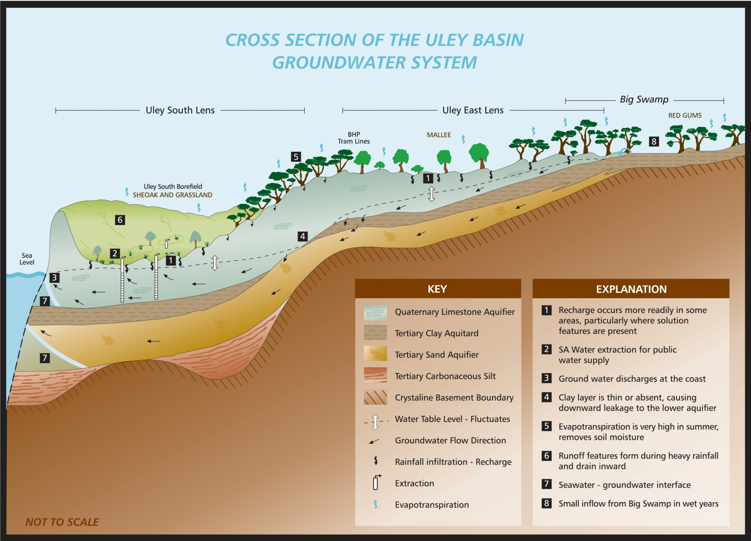
Sample Conceptual Model
Notes:
http://www.epnrm.sa.gov.au/Water/Groundwater.aspx

Slide 6
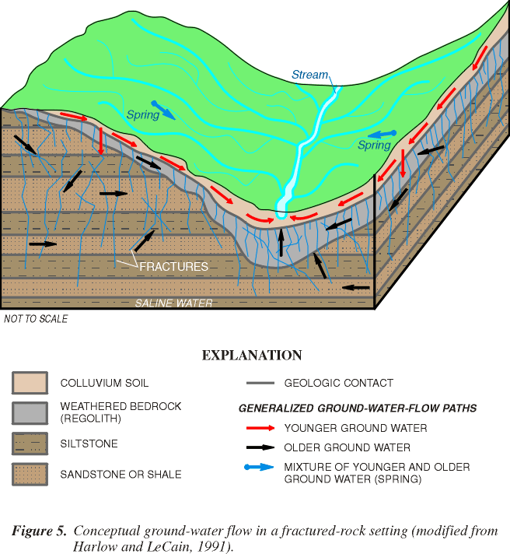
Sample Conceptual Model
Notes:
http://md.water.usgs.gov/publications/fs-150-99/html/index.htm

Slide 7
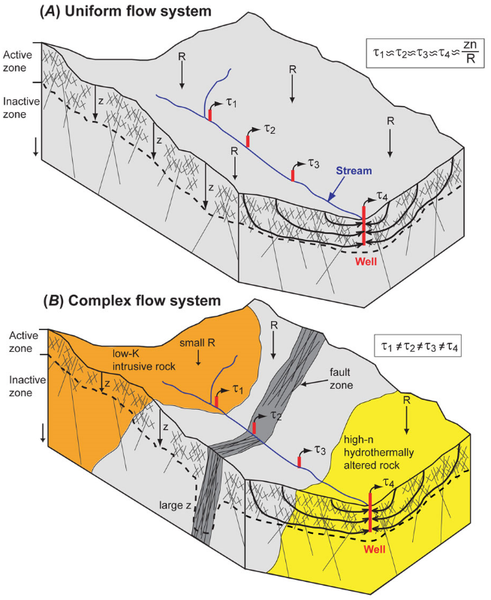
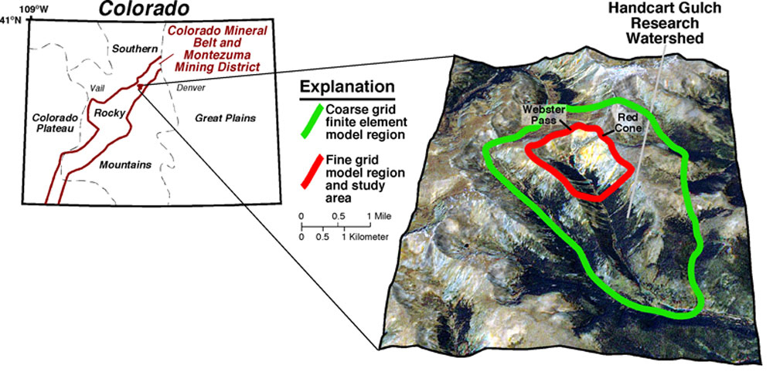
Alternate Conceptual Models
Notes:
http://crustal.usgs.gov/projects/Handcart_Gulch/watershed.html

Slide 8

Parsimony
Keep the model complex enough to be useful, but simple enough to be manageable
“Everything should be made as simple as possible. But not simpler.”
– Albert Einstein

Slide 9
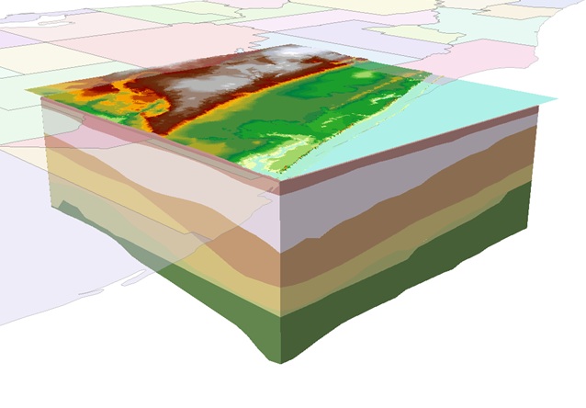
Characterize Aquifer Units
Determine principal hydrogeologic units
Hydrogeologic Unit
A zone that exhibits common hydraulic properties
May include multiple geologic units

Slide 10
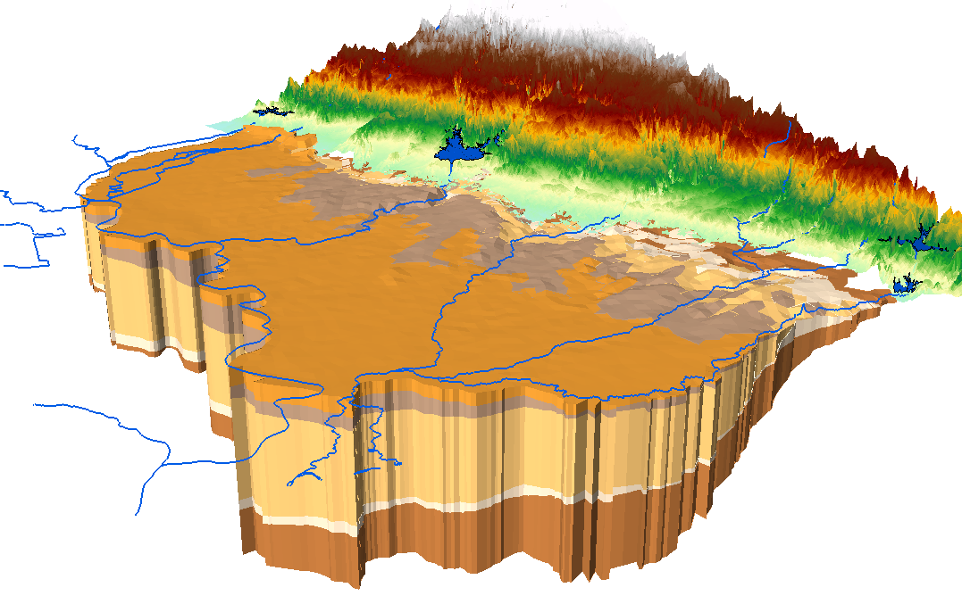
Hydrogeologic Units

Slide 11
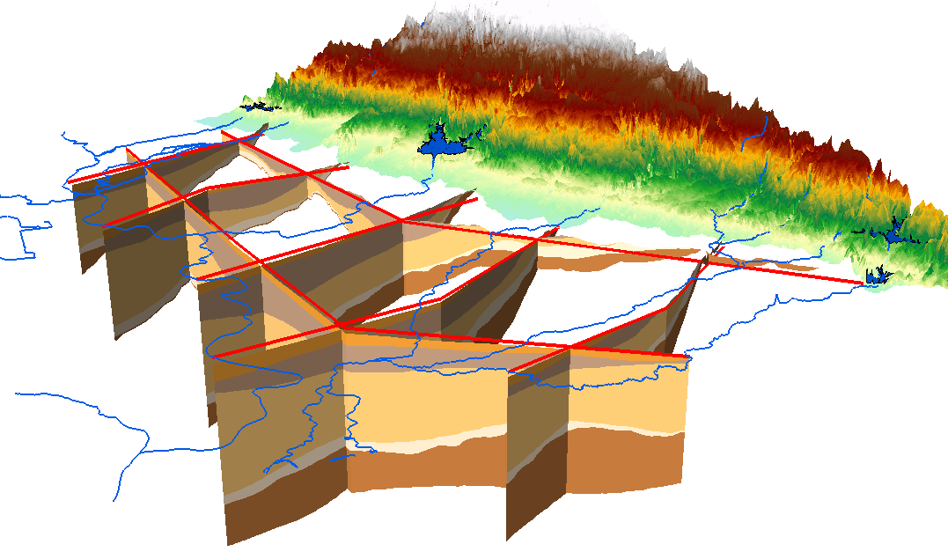
Hydrogeologic Units

Slide 12
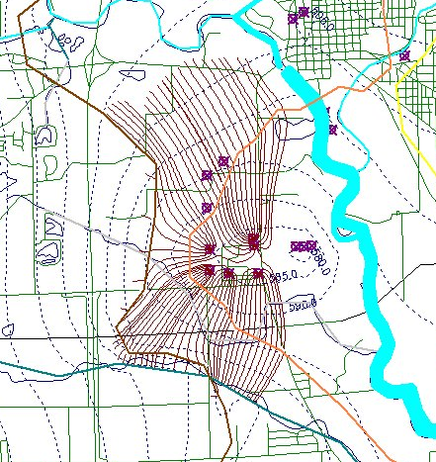
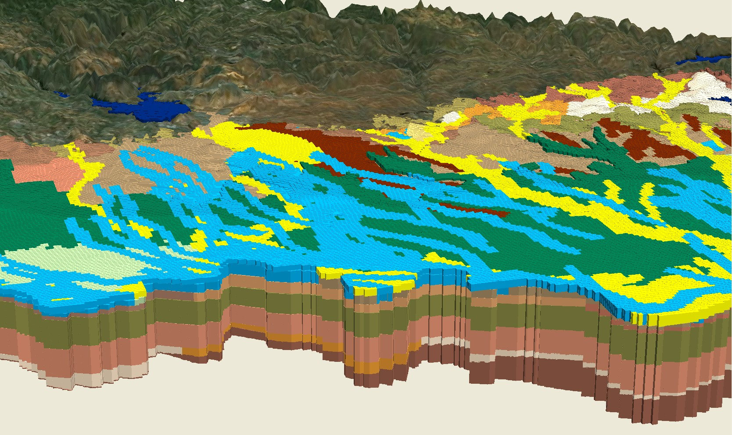
2D vs. 3D?
Is the flow primarily horizontal?
Is it necessary to capture the vertical component of flow in light of the modeling objectives?
Regional vs. local model?
How much data is available?

Slide 13
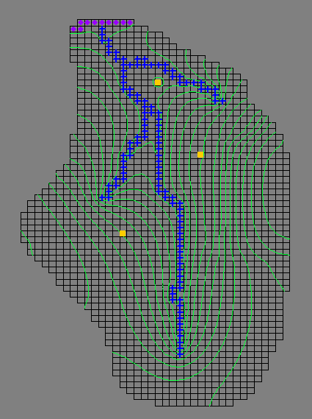
2D Areal Models
Single layer models
Used when flow is primarily horizontal

Slide 14
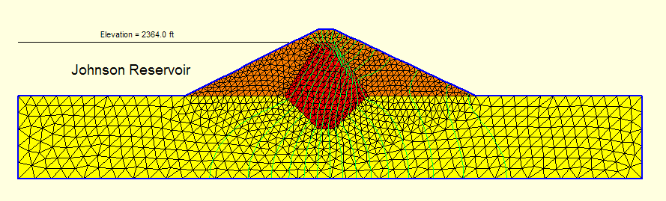
2D Profile Models
Used when flow field is constant along a horizontal axis

Slide 15
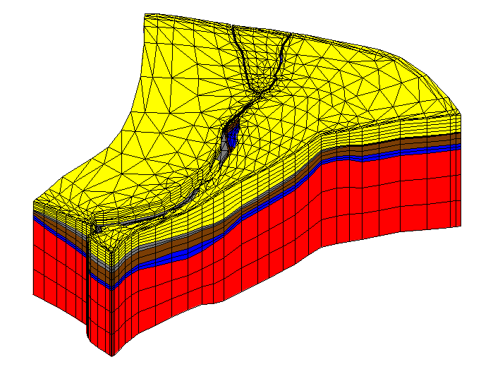
Full 3D Models
Full 3D equations are solved for each point in the model
Used when vertical component of flow is important to modeling objectives

Slide 16
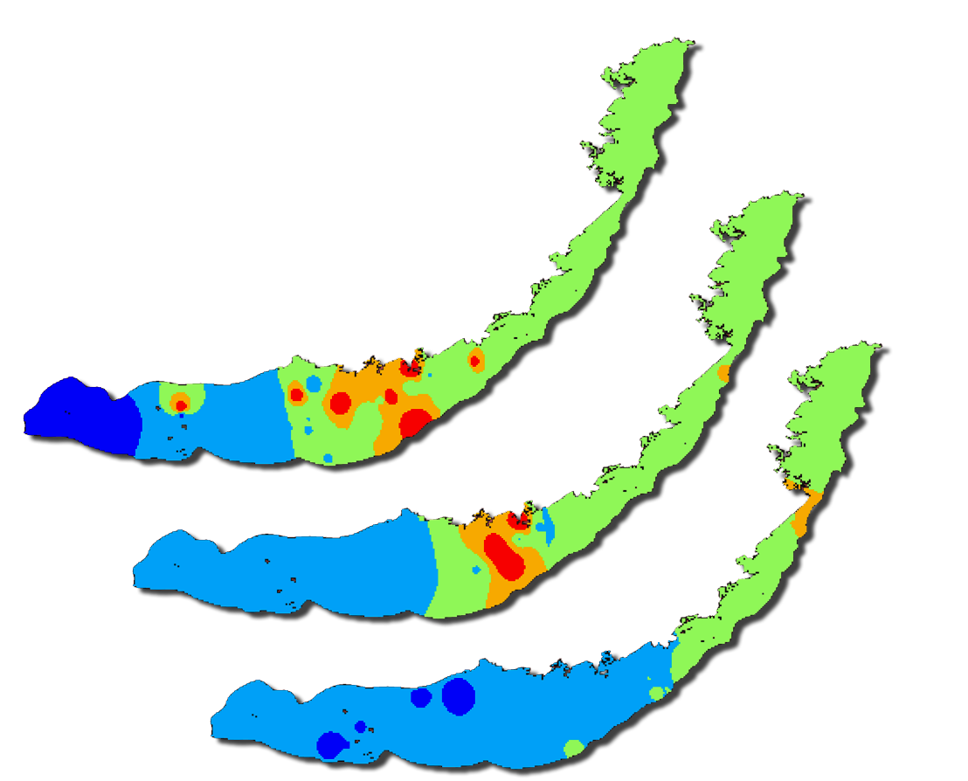
Steady State vs. Transient
How significant are the transient stresses?
How close are the stresses to the critical parts of the model?
Is sufficient transient data available?
1991
1992
1993

Slide 17
Boundary Conditions
How far should the model be extended?
No-Flow
Physical barrier (e.g. bedrock outcropping)
Groundwater divide
Parallel flow boundary
Head
Constant head (strong source/sink)
Head dependent (river, drain, lake)

Slide 18
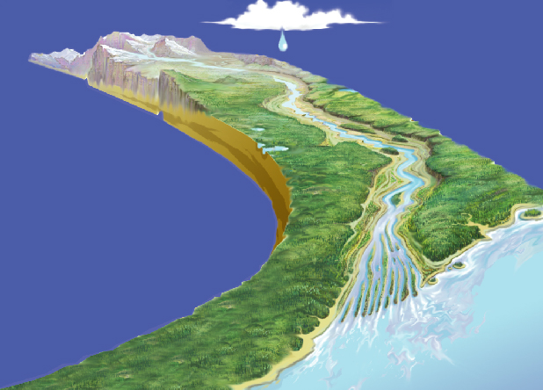
Sources and Sinks
What are the main sources and sinks you want to include in the model?
Rivers
Drains
Lakes,
Reservoirs, Springs
Wells
etc.

Slide 19
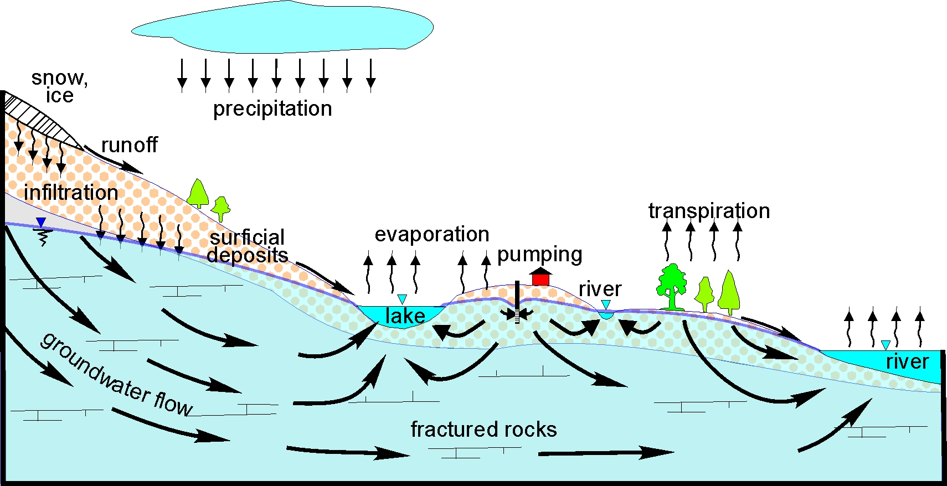
Water Budget
Determine a water budget for the site in question
Includes an estimate of the total inflows and outflows
Notes:
http://ess.nrcan.gc.ca/2002_2006/gwp/p3/a9/index_e.php

Slide 20
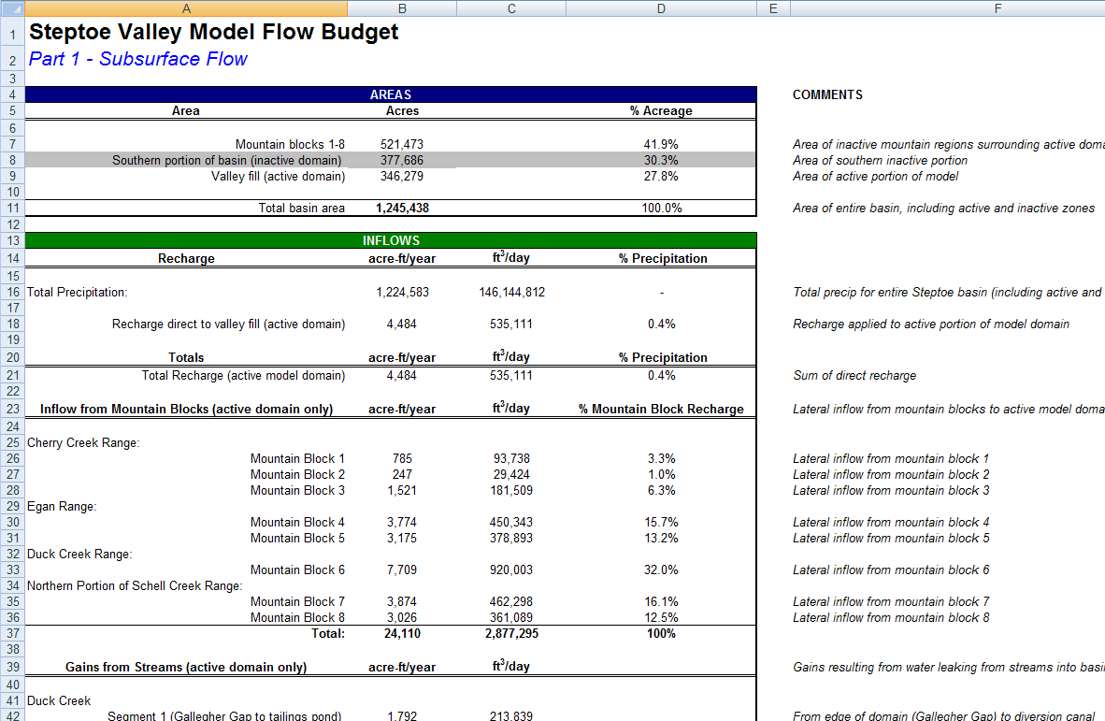
Water Budget

